Slide 1
Cryptography and Network Security
Third Edition
by William Stallings
Lecture slides by Lawrie Brown

Slide 2
Chapter 4 – Finite Fields
The next morning at daybreak, Star flew indoors, seemingly keen for a lesson. I said, "Tap eight." She did a brilliant exhibition, first tapping it in 4, 4, then giving me a hasty glance and doing it in 2, 2, 2, 2, before coming for her nut. It is astonishing that Star learned to count up to 8 with no difficulty, and of her own accord discovered that each number could be given with various different divisions, this leaving no doubt that she was consciously thinking each number. In fact, she did mental arithmetic, although unable, like humans, to name the numbers. But she learned to recognize their spoken names almost immediately and was able to remember the sounds of the names. Star is unique as a wild bird, who of her own free will pursued the science of numbers with keen interest and astonishing intelligence.
— Living with Birds, Len Howard

Slide 3
Introduction
will now introduce finite fields
of increasing importance in cryptography
  AES, Elliptic Curve, IDEA, Public Key
concern operations on “numbers”
  where what constitutes a “number” and the type of operations varies considerably
start with concepts of groups, rings, fields from abstract algebra

Slide 4
Group
a set of elements or “numbers”
with some operation whose result is also in the set (closure)
obeys:
  associative law: (a.b).c = a.(b.c)
  has identity e: e.a = a.e = a
  has inverses a⁻¹: a.a⁻¹ = e
if commutative a.b = b.a
  then forms an abelian group
Notes:
Have used . as operator – could be addition +, multiplication x or any other mathematical operator.
Note that integers (+ve, -ve and 0) using addition form an infinite abelian group. So do real numbers using multiplication.

Slide 5
Cyclic Group
define exponentiation as repeated application of operator
  example: a⁻³ = a.a.a
and let identity be: e=a⁰
a group is cyclic if every element is a power of some fixed element
  ie b = a^{k} for some a and every b in group
a is said to be a generator of the group

Slide 6
Ring
a set of “numbers” with two operations (addition and multiplication) which are:
an abelian group with addition operation
multiplication:
  has closure
  is associative
  distributive over addition: a(b+c) = ab + ac
if multiplication operation is commutative, it forms a commutative ring
if multiplication operation has inverses and no zero divisors, it forms an integral domain
Notes:
In essence, a ring is a set in which we can do addition, subtraction [a – b = a + (–b)], and multiplication without leaving the set.
With respect to addition and multiplication, the set of all n-square matrices over the real numbers form a ring.

Slide 7
Field
a set of numbers with two operations:
  abelian group for addition
  abelian group for multiplication (ignoring 0)
  ring
Notes:
In essence, a field is a set in which we can do addition, subtraction, multiplication, and division without leaving the set. Division is defined with the following rule: a/b = a (b^{–1})
Examples of fields are: rational numbers, real numbers, complex numbers. Note that integers are NOT a field since there are no multiplicative inverses (except for 1).
These are terms we use for different sorts of "number systems", ones obeying different sets of laws. From group to ring to field we get more and more laws being obeyed. As a memory aid, can use the acronym for groups is CAIN (Closure Associative Identity iNverse) & ABEL. Mostly we need to compute with Rings, if not Fields. When we do arithmetic modulo a prime, we have a field.

Slide 8
Modular Arithmetic
define modulo operator a mod n to be remainder when a is divided by n
use the term congruence for: a ≡ b mod n
  when divided by n, a & b have same remainder
  eg. 100 = 34 mod 11
b is called the residue of a mod n
  since with integers can always write: a = qn + b
usually have 0 <= b <= n-1
  -12 mod 7 ≡ -5 mod 7 ≡ 2 mod 7 ≡ 9 mod 7

Slide 9
Modulo 7 Example
...
-21 -20 -19 -18 -17 -16 -15
-14 -13 -12 -11 -10 -9 -8
-7 -6 -5 -4 -3 -2 -1
0 1 2 3 4 5 6
7 8 9 10 11 12 13
14 15 16 17 18 19 20
21 22 23 24 25 26 27
28 29 30 31 32 33 34
...
Notes:
When working modulo 7 have lists of congruences as shown – all numbers in a column are equivalent (have same remainder) and are called a residue class.
eg (-12 = -2 x 7 + 2) ≡ (-5 = -1 x 7 + 2) ≡ ( 2 = 0 x 7 + 2) ≡ ( 9 = 1 x 7 + 2) etc

Slide 10
Divisors
say a non-zero number b divides a if for some m have a=mb (a,b,m all integers)
that is b divides into a with no remainder
denote this b|a
and say that b is a divisor of a
eg. all of 1,2,3,4,6,8,12,24 divide 24

Slide 11
Modular Arithmetic Operations
is 'clock arithmetic'
uses a finite number of values, and loops back from either end
modular arithmetic is when do addition & multiplication and modulo reduce answer
can do reduction at any point, ie
  a+b mod n = [a mod n + b mod n] mod n
Notes:
When reducing, we "usually" want to find the positive remainder after dividing by the modulus. For positive numbers, this is simply the normal remainder. For negative numbers we have to "overshoot" (ie find the next multiple larger than the number) and "come back" (ie add a positive remainder to get the number); rather than have a "negative remainder".

Slide 12
Modular Arithmetic
can do modular arithmetic with any group of integers: Z_{n} = {0, 1, … , n-1}
form a commutative ring for addition
with a multiplicative identity
note some peculiarities
  if (a+b)≡(a+c) mod n then b≡c mod n
  but (ab)≡(ac) mod n then b≡c mod n only if a is relatively prime to n

Slide 13
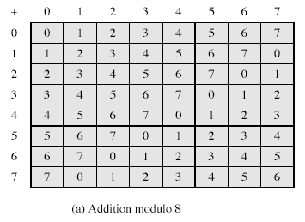
Modulo 8 Example
Notes:
From Stallings Table 4.1

Slide 14
Greatest Common Divisor (GCD)
a common problem in number theory
GCD (a,b) of a and b is the largest number that divides evenly into both a and b
  eg GCD(60,24) = 12
often want no common factors (except 1) and hence numbers are relatively prime
  eg GCD(8,15) = 1
  hence 8 & 15 are relatively prime

Slide 15
Euclid's GCD Algorithm
an efficient way to find the GCD(a,b)
uses theorem that:
  GCD(a,b) = GCD(b, a mod b)
Euclid's Algorithm to compute GCD(a,b):
  A=a, B=b
  while B>0
    R = A mod B
    A = B, B = R
  return A
Notes:
Euclid's Algorithm is derived from the observation that if a & b have a common factor d (ie. a=m.d & b=n.d) then d is also a factor in any difference between them, vis: a-p.b = (m.d)-p.(n.d) = d.(m-p.n). Euclid's Algorithm keeps computing successive differences until it vanishes, at which point that divisor has been reached.

Slide 16
Example GCD(1970,1066)
1970 = 1 x 1066 + 904 gcd(1066, 904)
1066 = 1 x 904 + 162 gcd(904, 162)
904 = 5 x 162 + 94 gcd(162, 94)
162 = 1 x 94 + 68 gcd(94, 68)
94 = 1 x 68 + 26 gcd(68, 26)
68 = 2 x 26 + 16 gcd(26, 16)
26 = 1 x 16 + 10 gcd(16, 10)
16 = 1 x 10 + 6 gcd(10, 6)
10 = 1 x 6 + 4 gcd(6, 4)
6 = 1 x 4 + 2 gcd(4, 2)
4 = 2 x 2 + 0 gcd(2, 0)
Notes:
Compute successive instances of GCD(a,b) = GCD(b,a mod b).
Note this MUST always terminate since will eventually get a mod b = 0 (ie no remainder left).

Slide 17
Galois Fields
finite fields play a key role in cryptography
can show number of elements in a finite field must be a power of a prime p^{n}
known as Galois fields
denoted GF(p^{n})
in particular often use the fields:
  GF(p)
  GF(2^{n})

Slide 18
Galois Fields GF(p)
GF(p) is the set of integers {0,1, … , p-1} with arithmetic operations modulo prime p
these form a finite field
  since have multiplicative inverses
hence arithmetic is “well-behaved” and can do addition, subtraction, multiplication, and division without leaving the field GF(p)

Slide 19
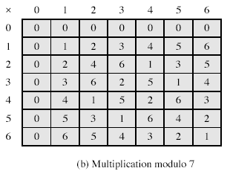
Example GF(7)
Notes:
From Stallings Table 4.3b

Slide 20
Finding Inverses
can extend Euclid’s algorithm:
  EXTENDED EUCLID(m, b)
  (A1, A2, A3)=(1, 0, m);
  (B1, B2, B3)=(0, 1, b)
  2. if B3 = 0
  return A3 = gcd(m, b); no inverse
  3. if B3 = 1
  return B3 = gcd(m, b); B2 = b^{–1} mod m
  4. Q = A3 div B3
  5. (T1, T2, T3)=(A1 – Q B1, A2 – Q B2, A3 – Q B3)
  6. (A1, A2, A3)=(B1, B2, B3)
  7. (B1, B2, B3)=(T1, T2, T3)
  8. goto 2

Slide 21
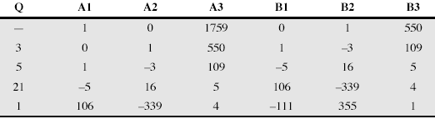
Inverse of 550 in GF(1759)

Slide 22

Polynomial Arithmetic
can compute using polynomials
several alternatives available
  ordinary polynomial arithmetic
  poly arithmetic with coords mod p
  poly arithmetic with coords mod p and polynomials mod M(x)

Slide 23
Ordinary Polynomial Arithmetic
add or subtract corresponding coefficients
multiply all terms by each other
eg
  let f(x) = x³ + x² + 2 and g(x) = x² – x + 1
  f(x) + g(x) = x³ + 2x² – x + 3
  f(x) – g(x) = x³ + x + 1
  f(x) x g(x) = x⁵ + 3x² – 2x + 2

Slide 24
Polynomial Arithmetic with Modulo Coefficients
when computing value of each coefficient do calculation modulo some value
could be modulo any prime
but we are most interested in mod 2
  ie all coefficients are 0 or 1
  eg. let f(x) = x³ + x² and g(x) = x² + x + 1
  f(x) + g(x) = x³ + x + 1
  f(x) x g(x) = x⁵ + x²

Slide 25
Modular Polynomial Arithmetic
can write any polynomial in the form:
  f(x) = q(x) g(x) + r(x)
  can interpret r(x) as being a remainder
  r(x) = f(x) mod g(x)
if have no remainder say g(x) divides f(x)
if g(x) has no divisors other than itself & 1 say it is irreducible (or prime) polynomial
arithmetic modulo an irreducible polynomial forms a field

Slide 26
Polynomial GCD
can find greatest common divisor for polys
  c(x) = GCD(a(x), b(x)) if c(x) is the poly of greatest degree which divides both a(x), b(x)
  can adapt Euclid’s Algorithm to find it:
  EUCLID[a(x), b(x)]
  A(x) = a(x); B(x) = b(x)
  2. if B(x) = 0 return A(x) = gcd[a(x), b(x)]
  3. R(x) = A(x) mod B(x)
  4. A(x) ¨ B(x)
  5. B(x) ¨ R(x)
  6. goto 2

Slide 27
Modular Polynomial Arithmetic
can compute in field GF(2^{n})
  polynomials with coefficients modulo 2
  whose degree is less than n
  hence must reduce modulo an irreducible poly of degree n (for multiplication only)
form a finite field
can always find an inverse
  can extend Euclid’s Inverse algorithm to find

Slide 28
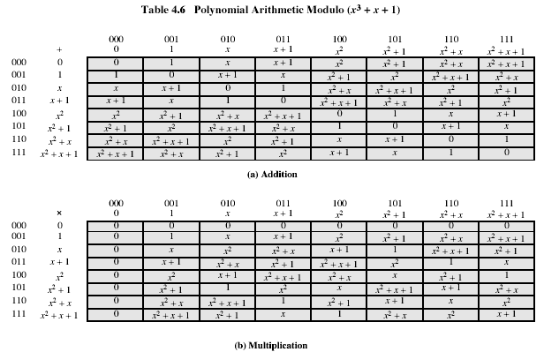
Example GF(2³)
Notes:
Stallings Table 4.6

Slide 29
Computational Considerations
since coefficients are 0 or 1, can represent any such polynomial as a bit string
addition becomes XOR of these bit strings
multiplication is shift & XOR
  cf long-hand multiplication
modulo reduction done by repeatedly substituting highest power with remainder of irreducible poly (also shift & XOR)
Notes:
See text for additional discussion. Reduction comes from observation that if in GF(2^{n}) then irreducible poly g(x) has highest term x^{n} , and if compute x^{n} mod g(x) answer is g(x)- x^{n}

Slide 30
Summary
have considered:
  concept of groups, rings, fields
  modular arithmetic with integers
  Euclid’s algorithm for GCD
  finite fields GF(p)
  polynomial arithmetic in general and in GF(2^{n})

